Slide 1

MASTERING THE AI FRONTIER
A Journey Through Artificial Intelligence, Machine Learning, Deep Learning, and the Generative Revolution

Slide 2
WHAT IS ARTIFICIAL INTELLIGENCE?
Simulation of Cognition: The ability of machines to mimic human problem-solving and decision-making capabilities.
Adaptive Learning: Unlike static code, AI systems improve their performance as they are exposed to more information.
Perception & Understanding: Enabling machines to "see" (Vision), "hear" (Audio), and "read" (Natural Language).
Autonomous Reasoning: Moving beyond programmed rules to logical inference and probabilistic outcome estimation.
Examples: Recommendation systems, chatbots, self-driving cars

Slide 3

MACHINE LEARNING VS. DEEP LEARNING
Machine Learning (ML)
Deep Learning (DL)
Focuses on algorithms that learn from structured data using statistical techniques. Often requires "feature engineering" where humans manually identify data attributes (e.g., age, price) for the model.
A subset of ML based on Artificial Neural Networks with multiple layers. It autonomously learns features from unstructured data like raw pixels or text, mimicking the human brain's neural pathways.
Analogy: ML = learning with rules, DL = learning with experience

Slide 4
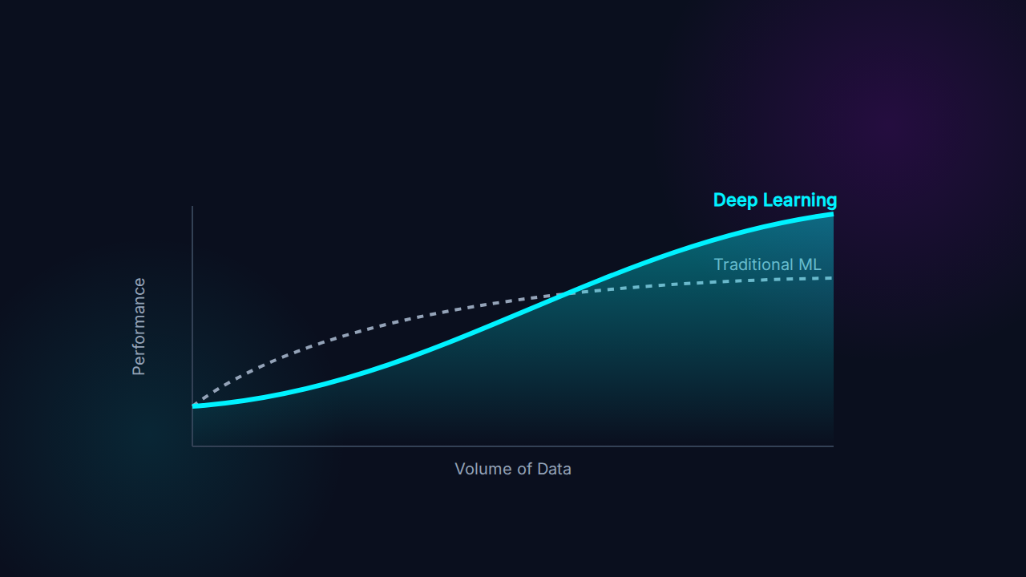
PERFORMANCE VS. DATA SCALING

Slide 5

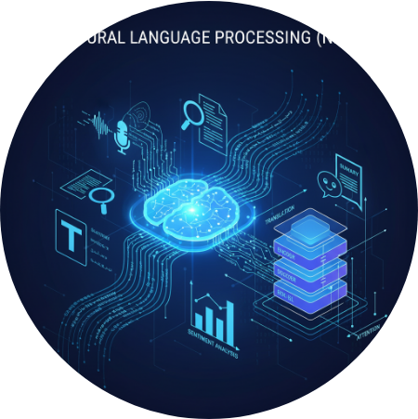
NLP: BRIDGING THE LANGUAGE GAP
Natural Language Processing
NLP allows machines to read, decipher, and make sense of human languages in a way that is valuable. From sentiment analysis and chatbots to real-time translation, it powers the interface between human thought and digital processing.
Example: “Alexa, play my favorite song.”

Slide 6





CORE PILLARS OF NLP
Summarization
Sentiment Analysis
NER (Entity Recognition)
Distilling long-form content into concise, meaningful summaries while retaining key context.
Identifying and extracting subjective information from source materials (positive, negative, neutral).
Locating and classifying named entities in text such as names, organizations, locations, and dates.

Slide 7
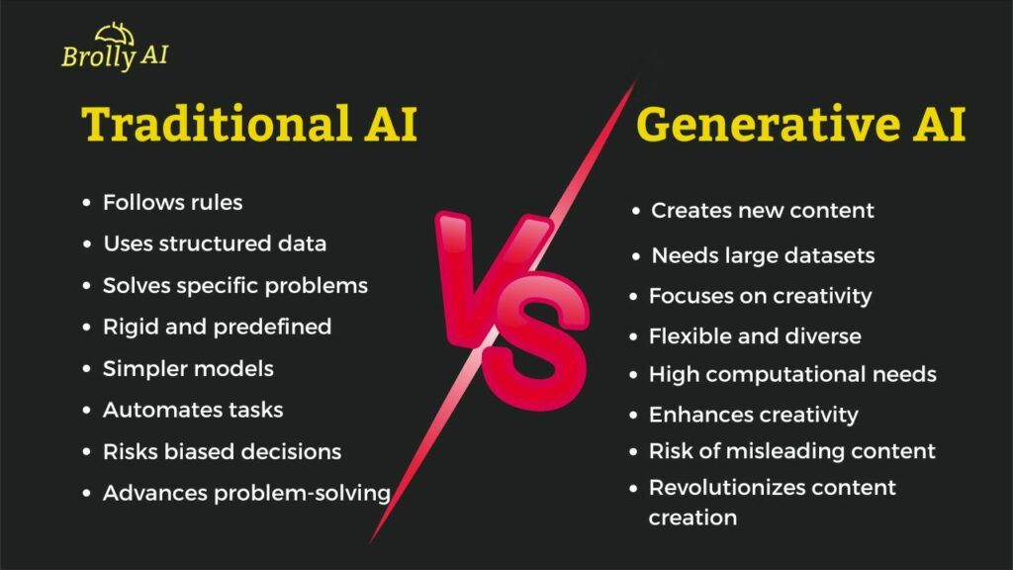
GENERATIVE AI:
THE CREATIVE LEAP
Generative AI represents a shift from machines that analyze data to machines that create it. Using Large Language Models (LLMs) and Diffusion techniques, these systems generate original text, images, and code that rival human creativity.

Slide 8
GENERATIVE AI ECOSYSTEM
Tool Name | Category | Core Architecture | Primary Use Case
ChatGPT / Claude | Text Generation | Transformer (LLM) | Reasoning, Coding, Content Writing
Midjourney | Image Generation | Diffusion Model | Artistic Design & Photorealistic Art
GitHub Copilot | Code Generation | OpenAI Codex | Real-time Programming Assistance
Runway Gen-3 | Video Generation | Video Diffusion | Cinematic Motion Content
Examples: ChatGPT, Copilot, DALL·E, Stable Diffusion

Slide 9
QUESTIONS?

